Slide 1
Predictive Modeling
Introduction and Fundamentals

Slide 2
Introduction
Predictive Modeling – Building of a statistical model (set of rules) for predicting or estimating an outcome’s value based on the value of one or more input variables.
Predictive analytics is a useful skill for tackling the following questions-
How can I predict a continuous or categorical outcome using a set of predictors such that the difference between our predictions and answer is as small as possible?
How can I make correct predictions about an outcome without knowing the underlying process that produced the outcome?
How can I predict an outcome with a lot of potential predictors without knowing which ones are important?

Slide 3
Steps of building a predictive model
Choose your outcome of interest
Think about variables related to the outcome of interest
Gather data before and after the outcome occurs
Enter/Clean/Transform data as required
Create new variables from existing data
Fit a predictive model algorithm
Examine a models performance
Make adjustments to data/model
Keep model

Slide 4
Data and Scaling
Scales of measurement (Nominal, Ordinal, Interval, Ratio)
Qualitative vs Quantitative
Importance of scaling-
The prediction method we choose differs depending on the scale type
Different scales provide different amount of information
Different scales help examine relationships accurately
Using different scaling might make the data invalid

Slide 5
Data and Scaling contd.
Nominal Scaling: Unordered Categories/Labels (Categories with no definite order). Example- Gender, Zipcode, Political affiliation
Ordinal Scaling: Ordered Values/Ranks (Values that have a natural order). Example- Ranking, School year
Interval Scaling: Equally spaced numbers (Ordered measurement in equally spaced units. Example- Temperature, IQ, SAT scores
Ratio Scaling: Equally spaced numbers with a true zero. Example- Height, Work Experience

Slide 6
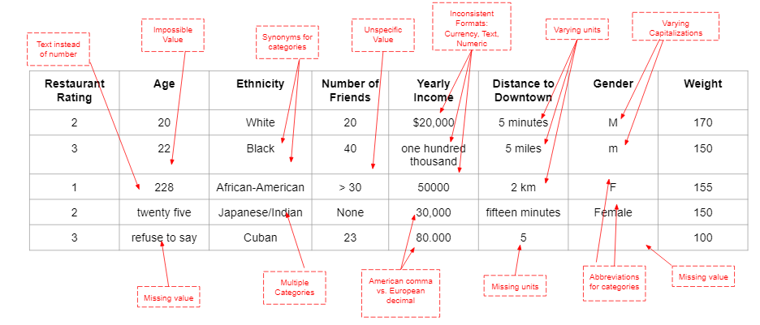
Data Cleaning
Common steps for data cleaning-
Check for formatting errors
Check for impossible values
Check for outliers
Check for missing values
Check for inattention

Slide 7
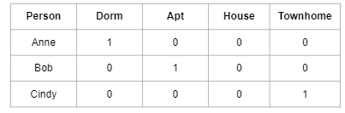
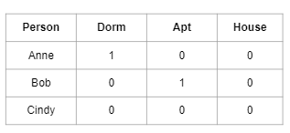
Data Restructuring
Converting qualitative nominal data using either one-hot-encoding or dummy coding
One-hot-encoding:
Each category is a separate variable/column
The category the person belongs to has a 1 in the corresponding column
The categories the person doesn’t belong to has a 0 in the corresponding column
Dummy coding:
Each category has a separate variable/column, except for one: the reference category
The reference category does not receive a predictor column
The category the person belongs to has a 1 in the corresponding column, if the category has a column
If the person does not belong to the category, the corresponding column has a 0 in it

Slide 8
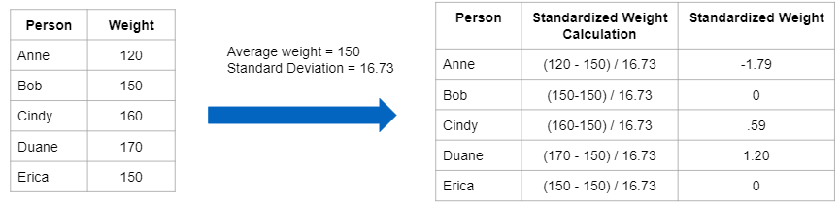
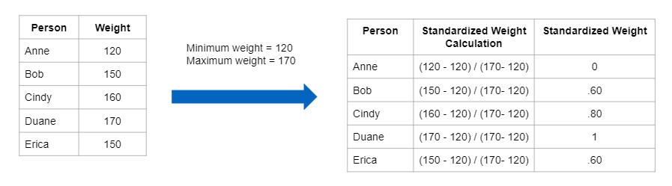
Data Standardization & Normalization
Standardization-
Find the mean of all of the recorded values of the variable
Find the standard deviation of all of the recorded values of the variable
For each value in the column, subtract the mean from it, and divide the difference by the standard deviation
Normalization-
Find the minimum and maximum value of all of the recorded values of the variable
Subtract the minimum value from the maximum value. This is your denominator
For each value in the column, subtract the minimum value from it, and divide it by the denominator you computed in step 3

Slide 9
Classification Vs Regression models
Introducing the two types of predictive models with examples
Importance of choosing the correct model
Goals of classification and regression algorithms
Classification Algorithms
Logistic Regression
Support Vector Machines
Classification Trees
Naïve Bayes
Regression Algorithms
Linear Regression
Multiple Regression
Regression Trees
Support Vector Regressors

Slide 10
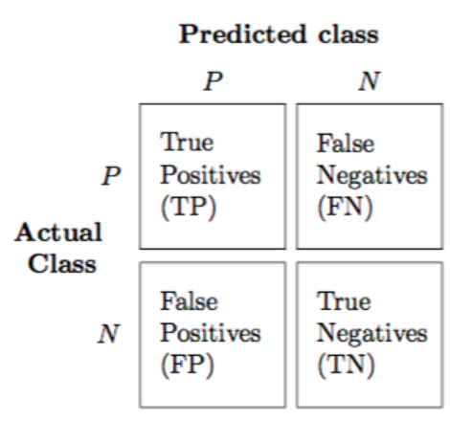
Evaluating Prediction Errors
Discuss the different measures of quantifying the performance of regression and classification predictions
Goal- Low error and high generalizability
Regression Models
R² : Describes the proportion of variation in the outcome that can be explained by the model. It is equal to the square of the correlation between the predictions and the actual value and ranges from 0% to 100%
Mean Absolute Error (MAE)
Root Mean Absolute Error (RMAE)
Classification Models
Confusion Matrix: Visual representation of performance of classification algorithms.
Mathews Correlation Coefficient
F1 Scores

Slide 11
Cross Validation
Discussing why generalizability is a problem (Overfitting, changes in time, changes in sample characteristics)
Evaluating generalizability of a model using K-Fold Cross Validation
K-Fold Cross Validation Steps-
We have a dataset with predictors and outcomes for N observations
We choose a K value where K is the number of times we want to split the data and test our model
Split the dataset so we have N/K cases left out
Train the model on the remaining cases (N-N/K)
Evaluate the training model by comparing predicted outcomes to the true outcomes
Repeat the process for the remaining cases
Combine (Average/Median) the evaluations to evaluate overall performance.

Slide 12
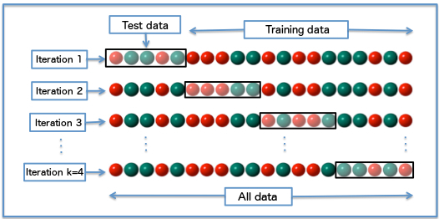
Cross Validation (contd.)
We generally use larger values for K since:
We get more variability in the models
performance estimate.
Better representation of the models
performance on new data
Limitations of K-Fold Cross Validation-
Cannot address changes in relationships over time
Cannot address unrepresentative samples
Does not work when outcomes are skewed or imbalanced (Also introduce stratified K-Fold cross validation)

Slide 13
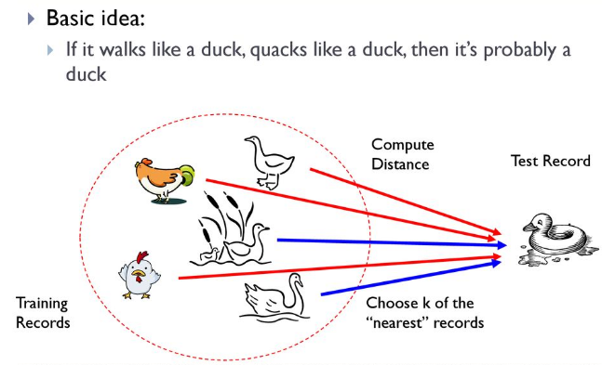
K Nearest Neighbors
K Nearest Neighbors is a classification and regression algorithm that makes a prediction based upon the closest data points
It involves comparing features for the new instance with the features from the instances we have already collected.
We can quantify how similar two objects distance vectors are using either the Euclidean distance or the City Block (Manhattan) distance as metrics

Slide 14
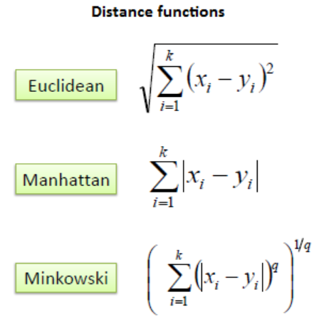
K Nearest Neighbors (contd.)
Algorithm Steps
For a given point, we calculate the distance to all the other points.
We then pick up the k closest points.
Calculate the probability of each class label given those points
The original point is classified with the label with the largest probability
Benefits
Training is very fast
Handles complex relationships between variables an outcomes.
Easy to calculate/explain
Limitations
Slow to make predictions
Does not handle many predictors well
Must standardize variables first
Must have large datasets

Slide 15
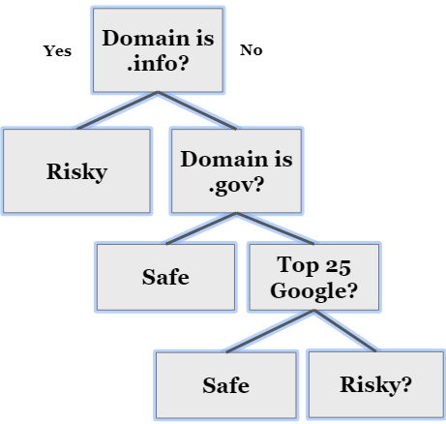
Decision Trees
Decision trees are flexible and powerful method of finding how an outcome relates to the values of many predictors.
Decision trees make use of many different variables to determine which group a case belong to based on the values of its variables
Goal- To ask a series of questions that separate our
Example: Classifying whether a website is “safe” or “risky”
Can know if a website is risky based on its domain and Google rank
If “.info” domain, risky

Slide 16
Decision Trees(contd.)
Algorithm Steps-
Start with a dataset which includes outcome categories and variables associated with it.
Split on every possible value of the outcome variable
Split points into two groups based on whether they are above or below that value
Examine the purity (separation between groups) from splitting at that point
Choose the variable and value for that variable that gives us the best change in purity measure
Repeat splitting process and keep explaining the exceptions till we reach a stopping point.
Benefits-
Relationship between outcome and predictors are clear
Easy to understand what variables are important in making predictions
Can examine non linear relationships between predictors and outcomes
Quick to calculate
Works for both classifications and regression problems.
Limitations-
Complex to find the best tree since we have many hyperparameters to search through
Tree models can be prone to overfitting

